Slide 1
OCR BASED CRVS FORM
Mock UI Presentation
1805064- Sanju Basak
1805074- Razin Reaz Abedin
1805080- Md. Erfan Jahangir

Slide 2
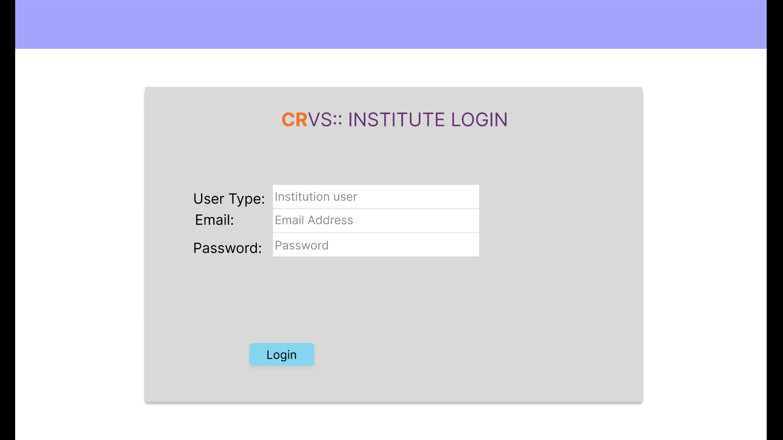
Login Page
After clicking to login page, home page will appear

Slide 3
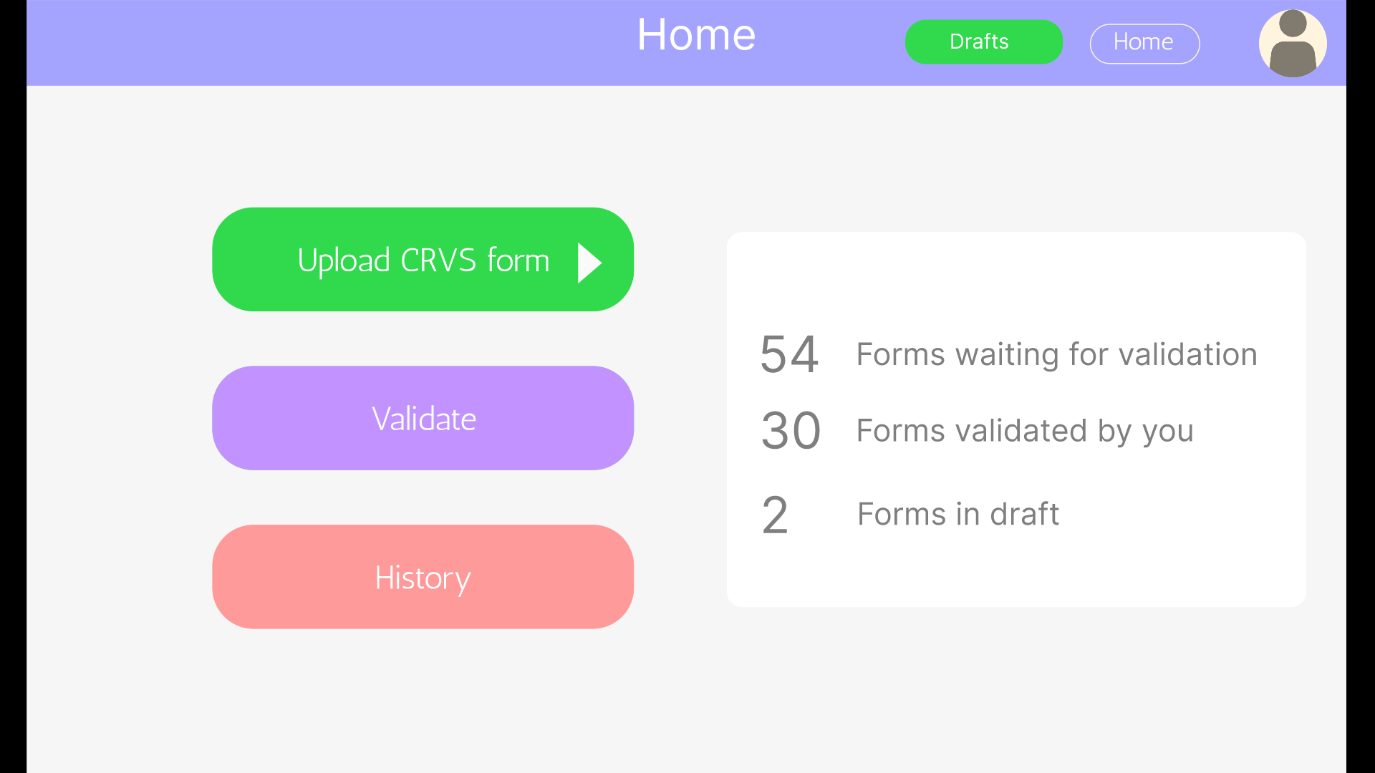
Home Page
After clicking upload CRVS form, we get two options:

Slide 4
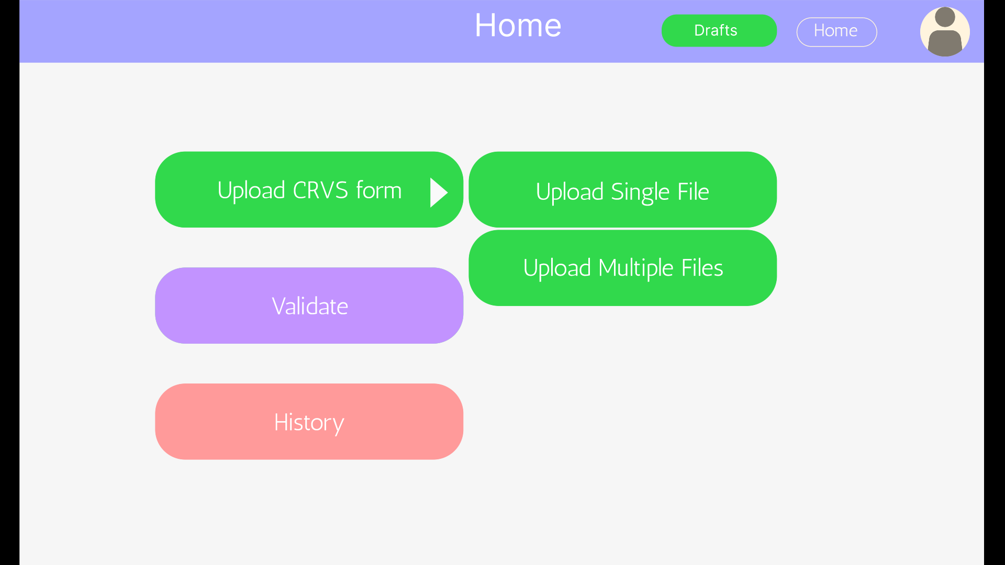
Home Page
One can upload
Single picture file (jpg, png)
Multiple file as zip

Slide 5
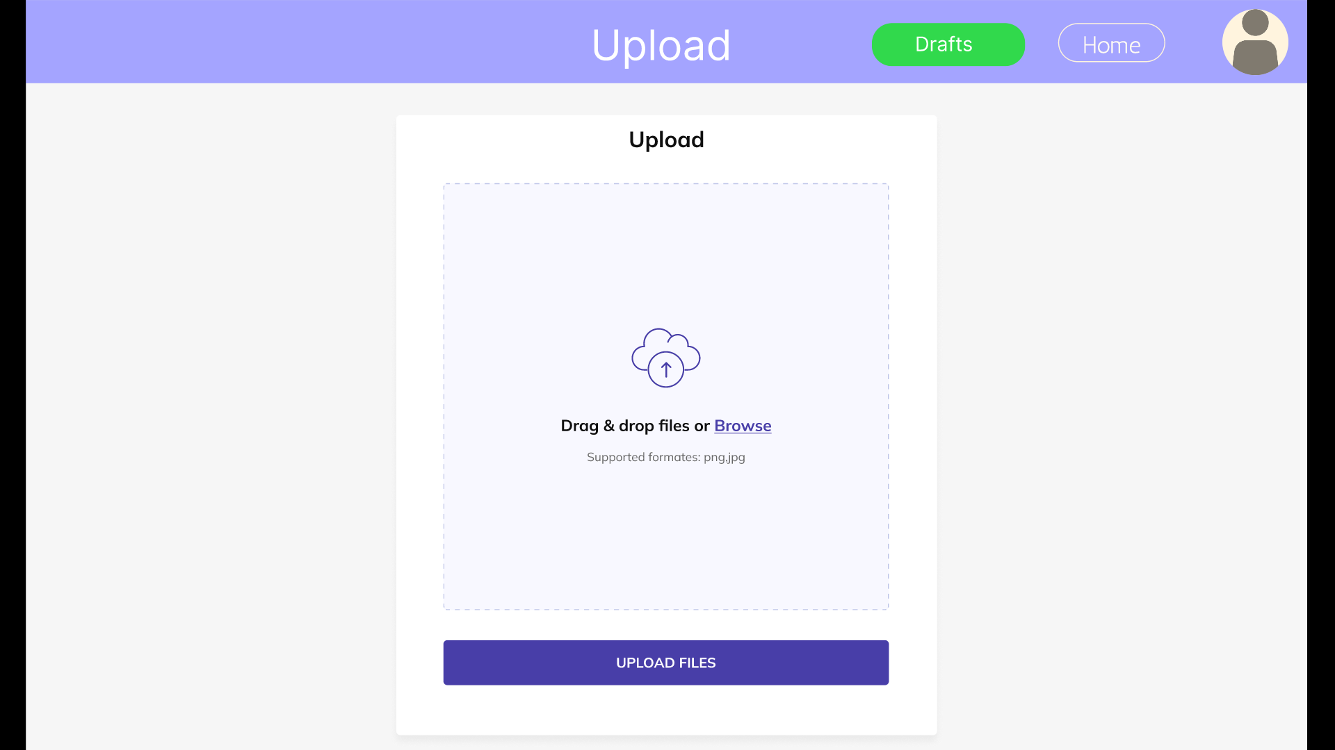
Single file upload

Slide 6
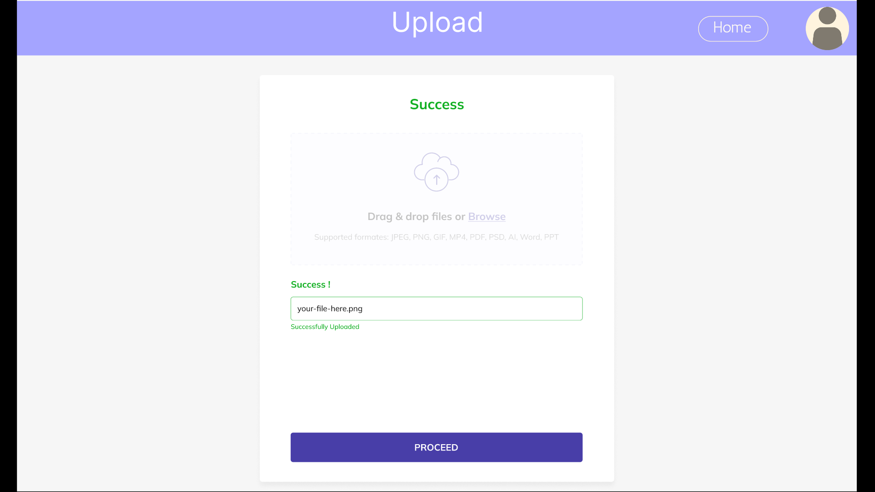
Single file upload
Only png or jpg formatted file is uploadable.

Slide 7
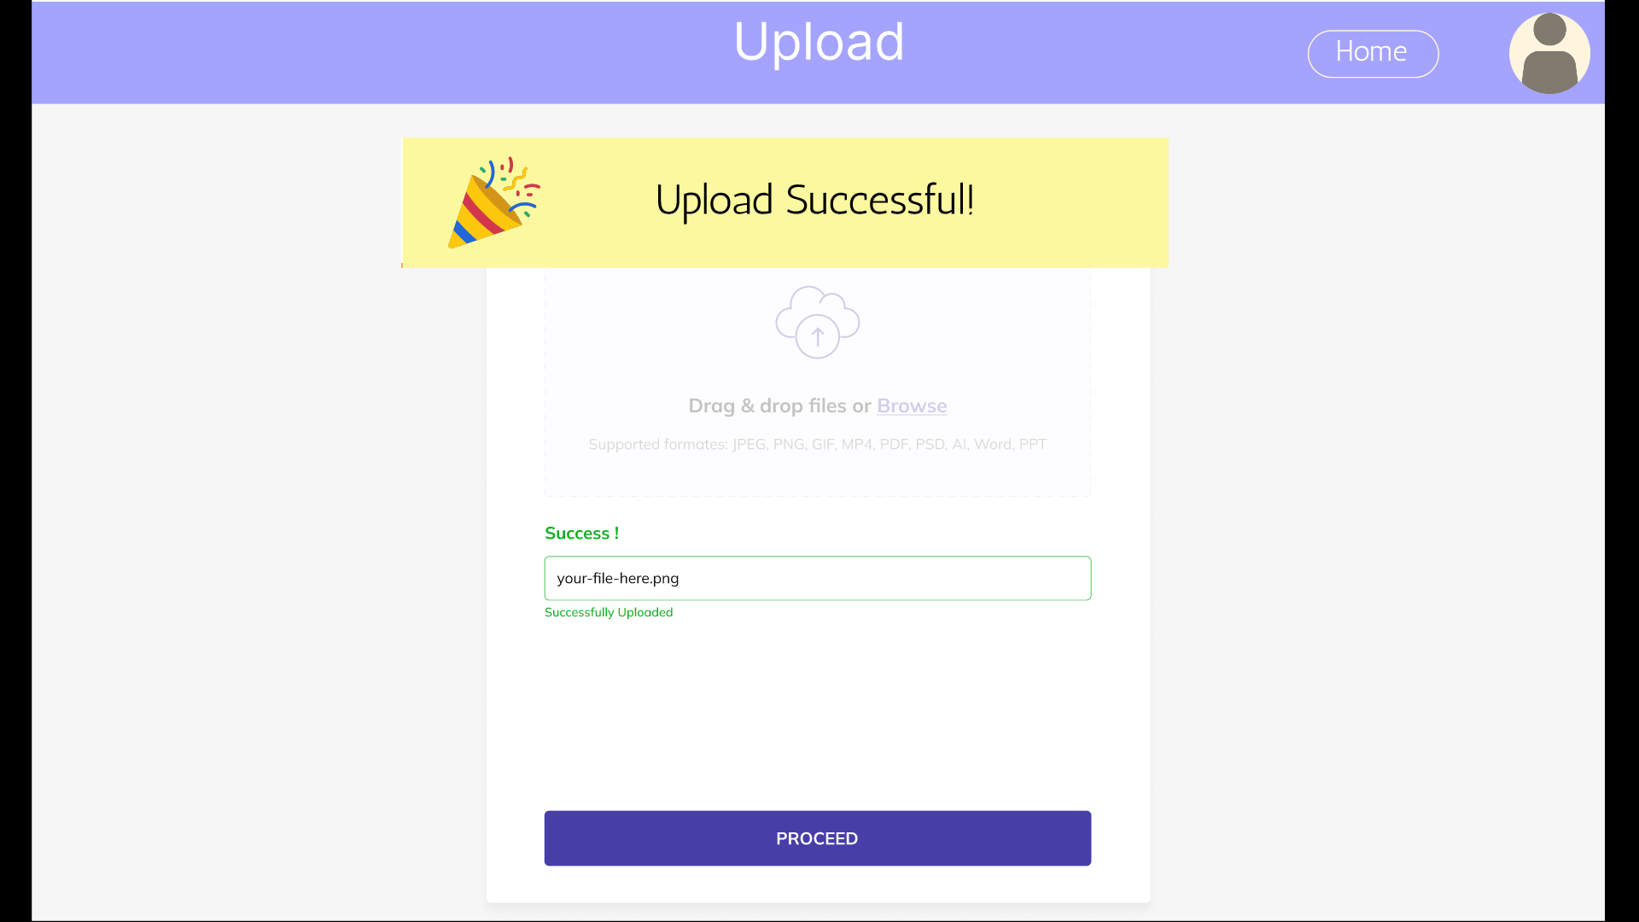
Upload Successful
After successfully uploaded, homepage will appear where one can validate the form

Slide 8
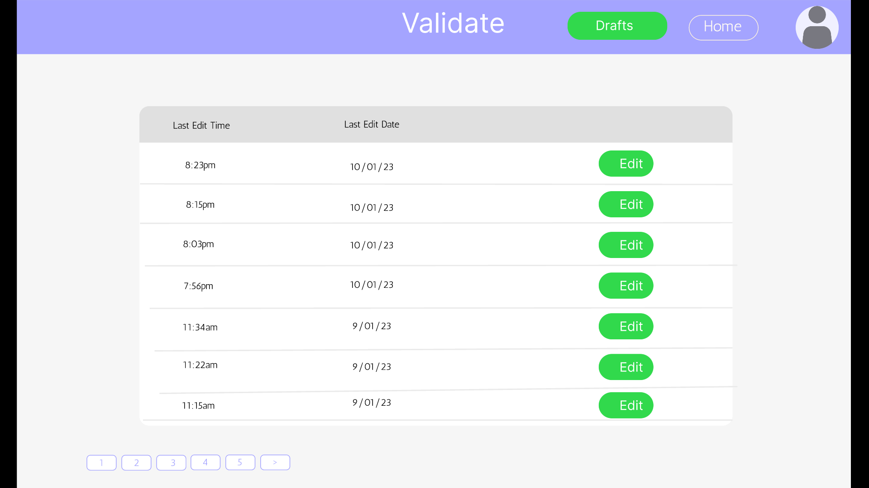
Validation
After clicking "Validate" menu, one will see all the forms need to validate from his institution.

Slide 9
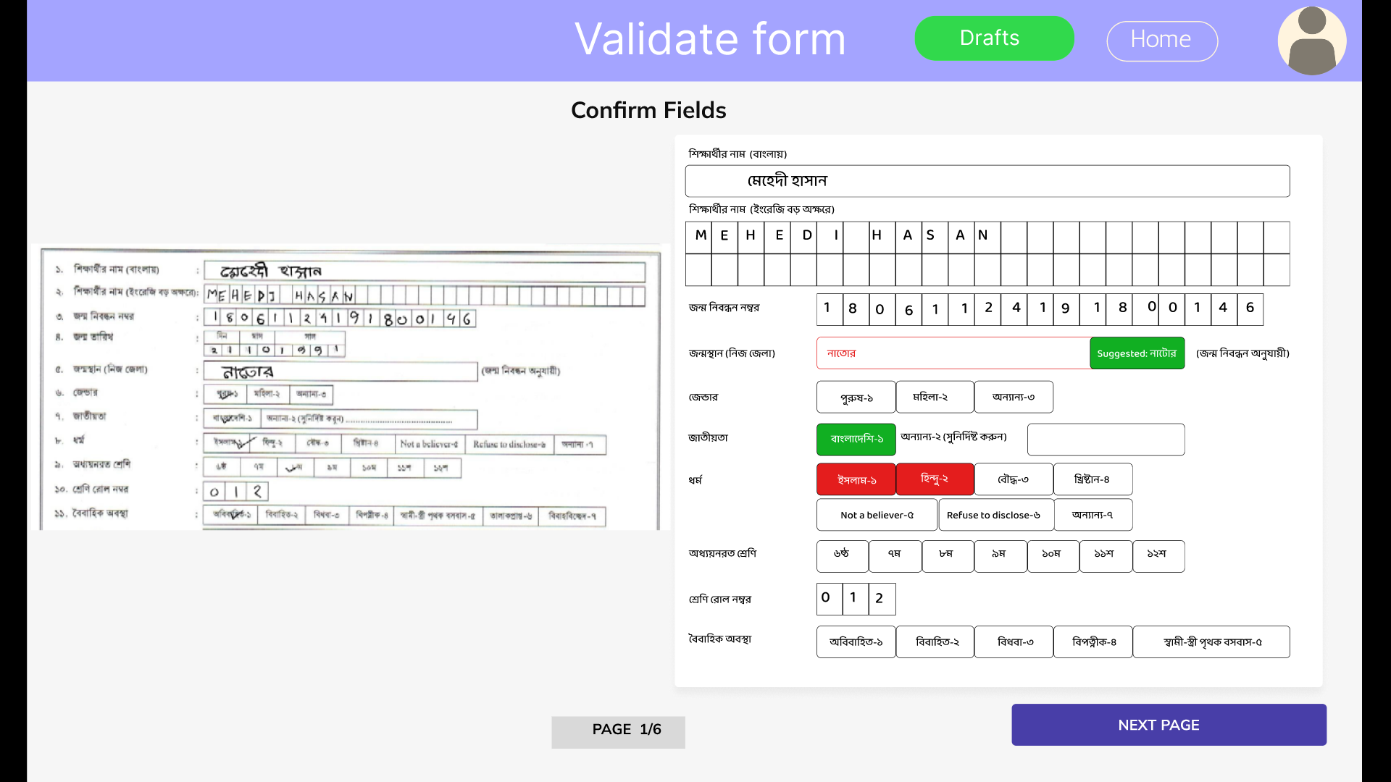
Validation
Here one can-
See side by side filled up form and digitized form
We will give some suggestions, where the teacher can edit the form and confirm to see next page
Here the time will be saved as no need to enter the whole form's data manually.

Slide 10
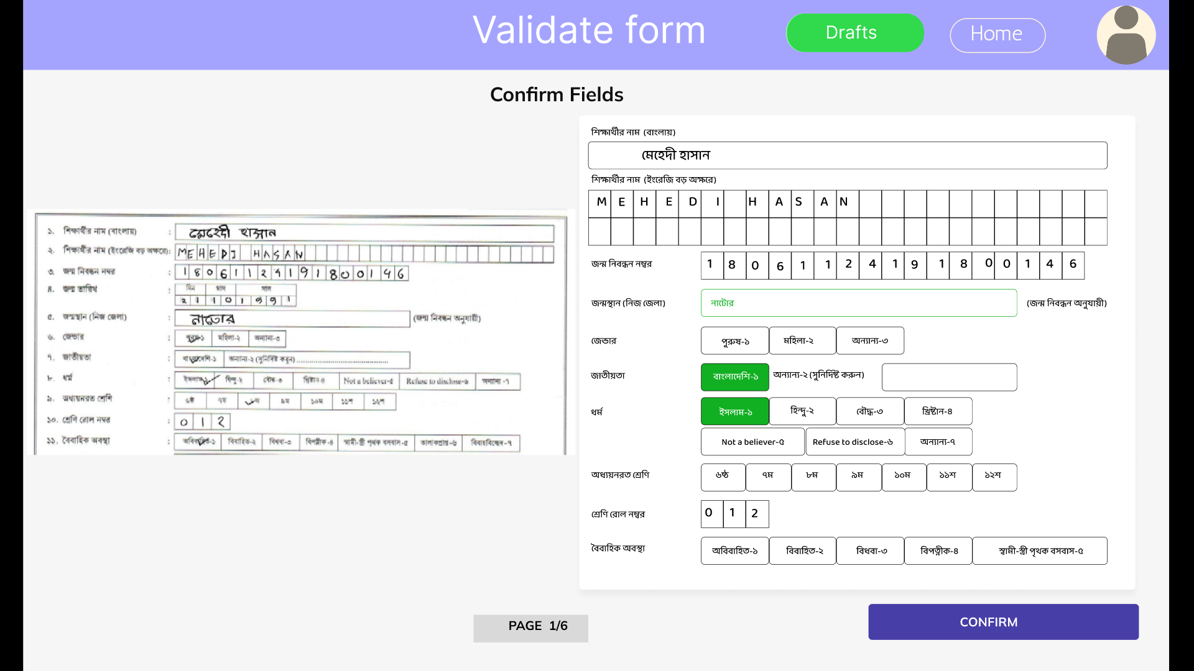
After changing
One can confirm this page to validate next page.
If someone clicked the exit button, the progress will be saved in draft.

Slide 11
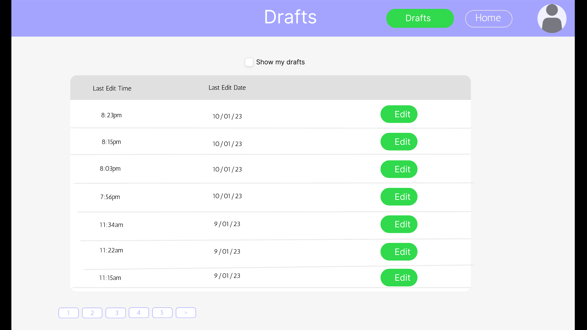
Drafts
After clicking the "draft" button, one can see all the drafts of his institution.

Slide 12
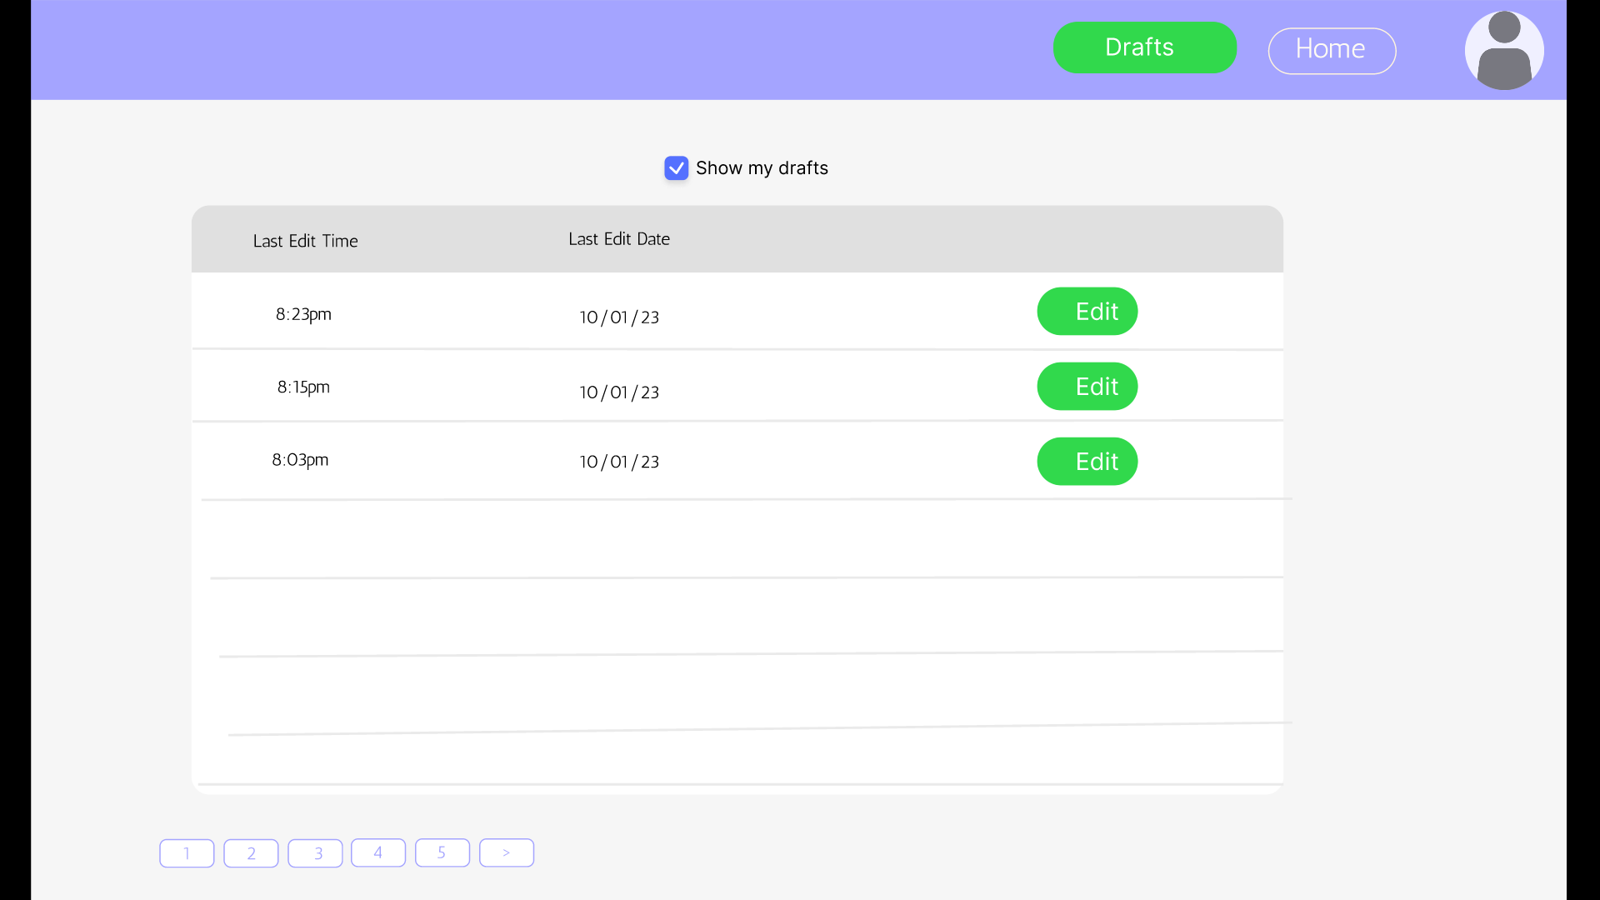
Drafts
One can see his own drafts, by selecting "Show my drafts" checkbox By clicking edit, one can validate the progressed form.

Slide 13
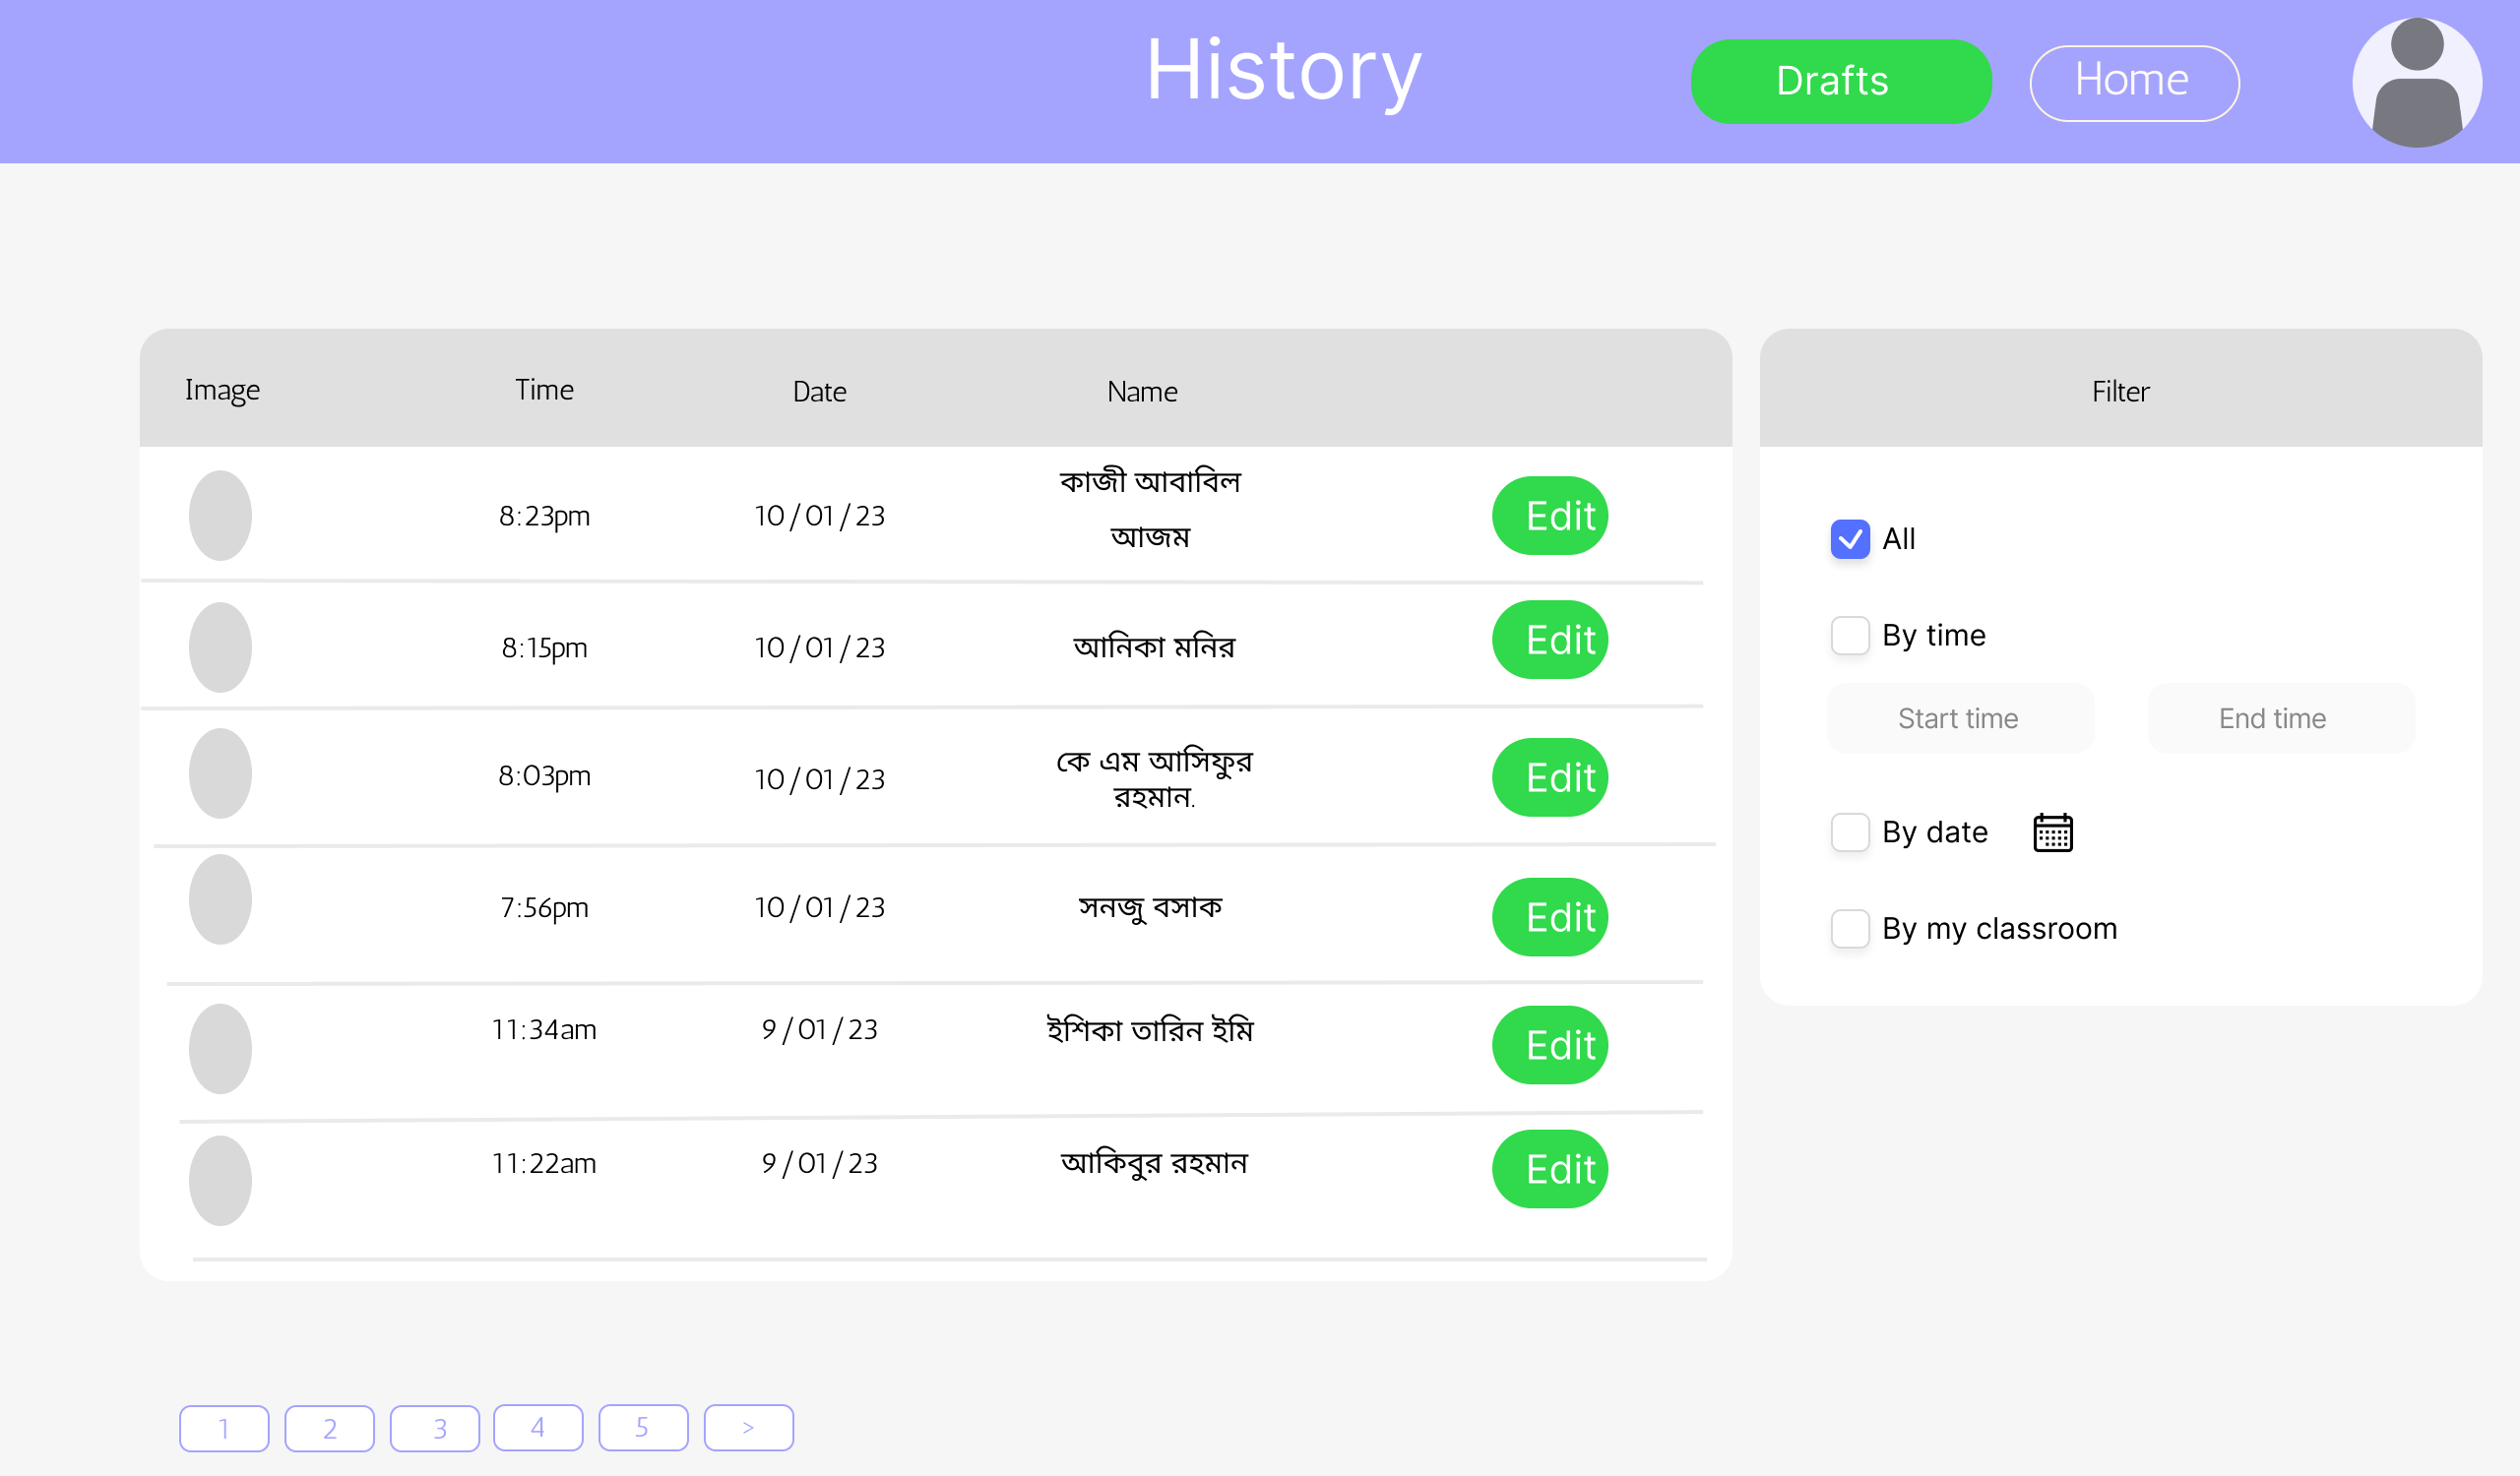
History
By clicking "History", one can see all the validated forms.
Here one can filter by time or date.

Slide 14
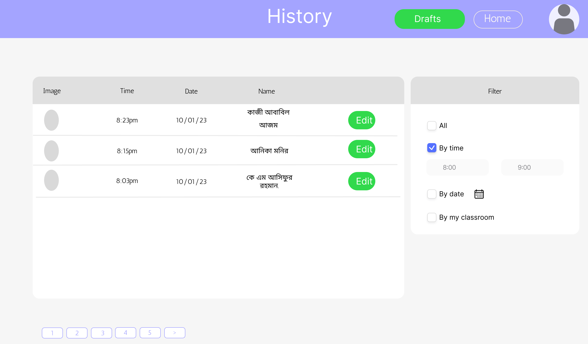
History
By selecting "By time", one can see the validated form of that time period.
We will also add the functionality, where one teacher can see, how many student's data are uploaded from his classroom.

Slide 15
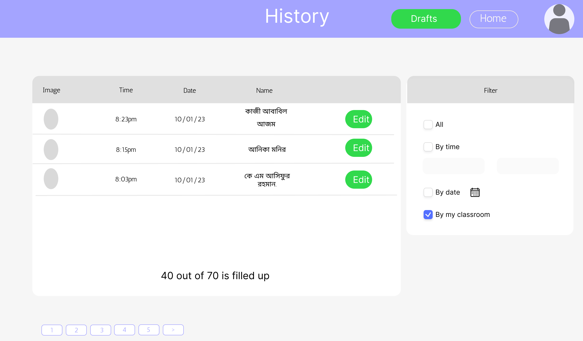
History
By selecting “By my classroom” filter one teacher can see how many student’s data are in the website out of total students.

Slide 16
Thank You

